Slide 1
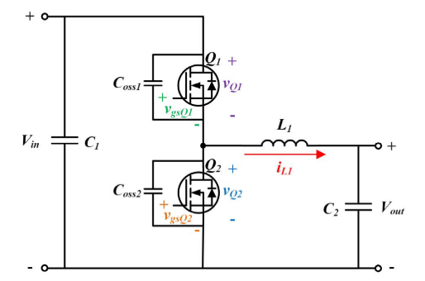
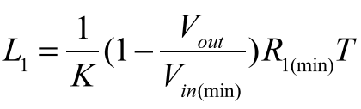

Synchronous Buck Converter with Zero-Voltage Resonant-Transition Switching
Simple Soft Switching
Additional passive and active components or a complicated loop control is not required
High conduction current due to high current ripple
Required condition for soft-switching:
Synchronous buck converter
K is proportional to input voltage
K is inv. prop. to maximum output current
The ratio between the peak-to-peak inductor current ripple and the average inductor current
Output load resitance
$$K∗t_{turn−off}=t_{turn−on}+t_{turn−off}$$
$$K=2 →t_{turn−on}=t_{turn−off}$$

Slide 2
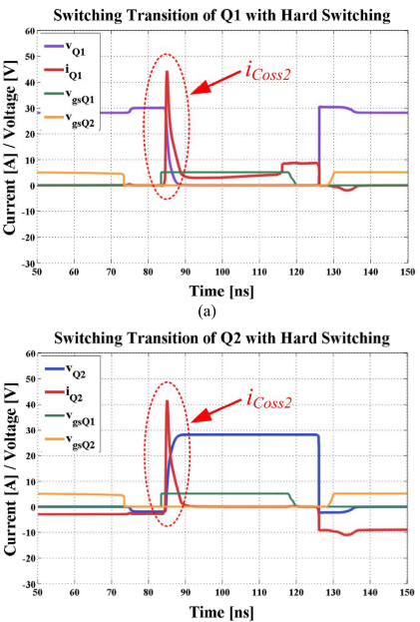
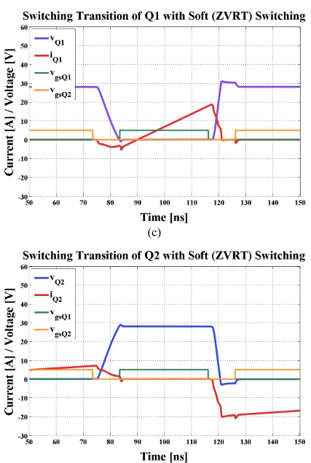
Spike on the switching current is removed
Unfortunately, the switching losses are still non-zero

Slide 3



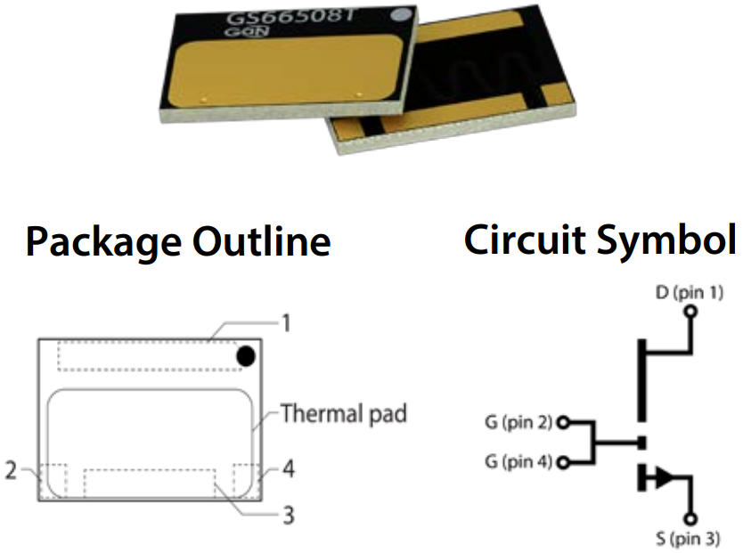
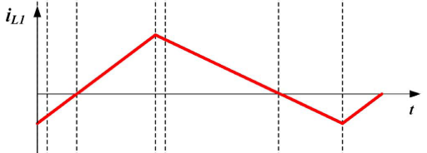
Loss Calculation
Transistor Parameters
GS66508T
650V / 30A
Top Cooling
Rds-on (150˚C) -> 129 mΩ
Coss -> 88 pF
DC
AC
Average Transition Time
Inductor Current

Slide 4
Loss Analysis
Vin = 540V
Vout = 400V
Iout = 20A
Pout = 8 kW
K = 4
Rise Time = 10 nsec
4 Parallel Transistor
3 Parallel Transistor

Slide 5
Loss Analysis
Vin = 540V
Vout = 400V
Iout = 10A
Pout = 4 kW
K = 4
Rise Time = 10 nsec
4 Parallel Transistor
2 Parallel Transistor

Slide 6
Loss Analysis
Vin = 220V
Vout = 150V
Iout = 20A
Pout = 3 kW
K = 4
Rise Time = 10 nsec
4 Parallel Transistor
3 Parallel Transistor

Slide 7
Loss Analysis
Vin = 220V
Vout = 150V
Iout = 10A
Pout = 1.5 kW
K = 4
Rise Time = 10 nsec
4 Parallel Transistor
3 Parallel Transistor

